Slide 1

DATA 606 CAPSTONE TITLE - USED CARS PRICE PREDICTION Arthi Komma – GF89659 Spring - 2024 Prepared under the guidance of Prof. Dr. Chaojie(Jay) Wang University Of Maryland At Baltimore County

Slide 2

OBJECTIVE
The objective of the Used Car Price Prediction project is to develop a machine learning model that accurately predicts the prices of used cars. This predictive model aims to assist both buyers and sellers in making informed decisions by providing reliable estimates of the market value of pre-owned vehicles.

Slide 3
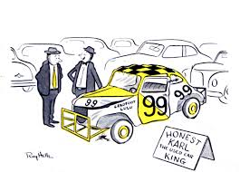
BACKGROUND
.The used car market is characterized by a multitude of factors that influence pricing, including the vehicle's make, model, year of manufacture, mileage, condition, geographical location, and market demand. Accurately determining the fair value of a used car can be challenging due to the complexity and variability of these factors.
Buyer Perspective: For buyers, having access to accurate price predictions helps in assessing whether a listed price is reasonable or overvalued, enabling them to negotiate effectively and make informed purchasing decisions.
Seller Perspective: Sellers benefit from understanding the market value of their vehicles, allowing them to set competitive prices that attract potential buyers while maximizing their returns.

Slide 4

DATASET OVERVIEW
The dataset used for the Used Car Price Prediction project contains information on various attributes of pre-owned vehicles and their corresponding sale prices. This dataset was collected from Kaggle, encompassing a wide range of car makes, models, years, and conditions.
Dataset Size: 277KB
Dataset Shape: The dataset consists of 2499 observations (rows) and 13 attributes (columns).
Target Variable: Price(Price of the car which is an integer)

Slide 5
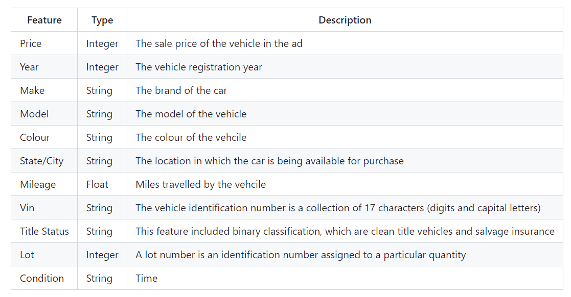
DATA DICTIONARY

Slide 6
METHODOLOGY
Data Collection
Data Cleaning/Preprocessing
Data Exploration and Visualization
Feature Engineering
Model Selection
Model Building
Evaluation
Deployment

Slide 7
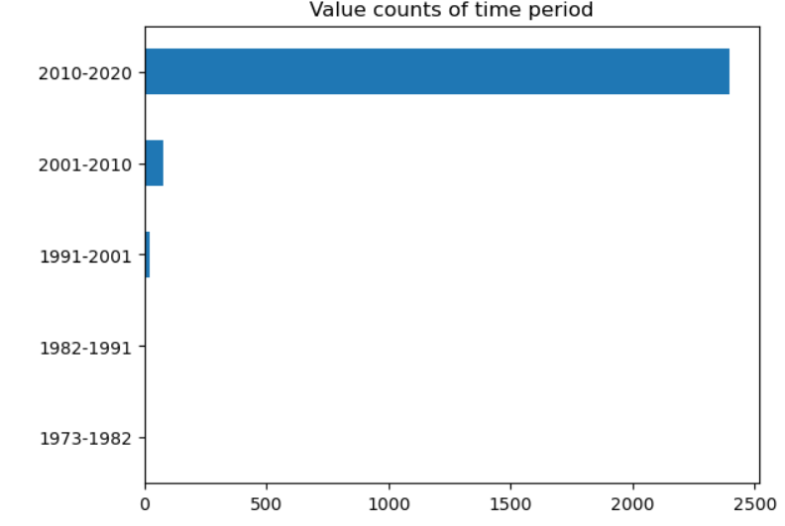
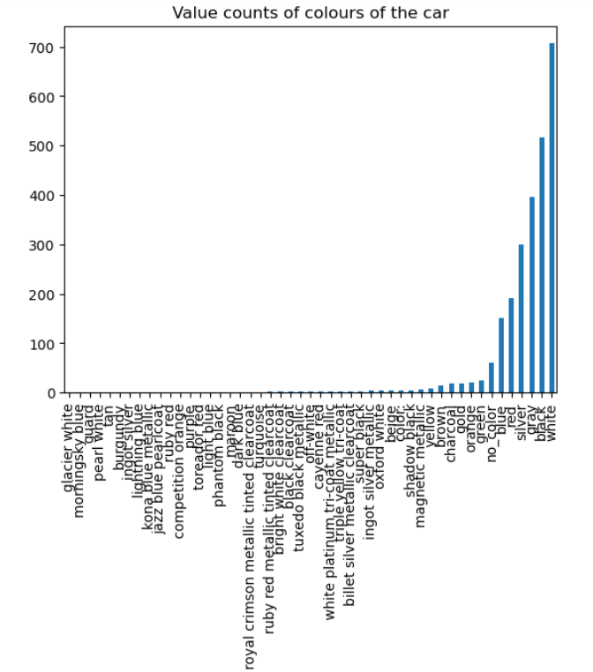
DATA VISUALIZATIONS

Slide 8
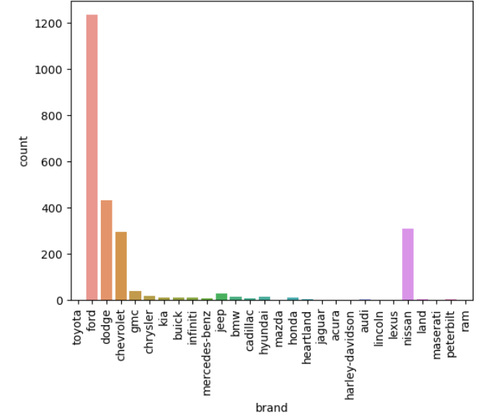
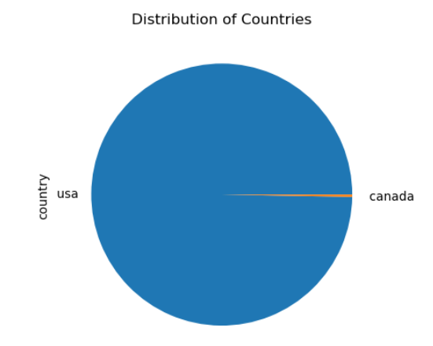
Value Counts of Brands

Slide 9
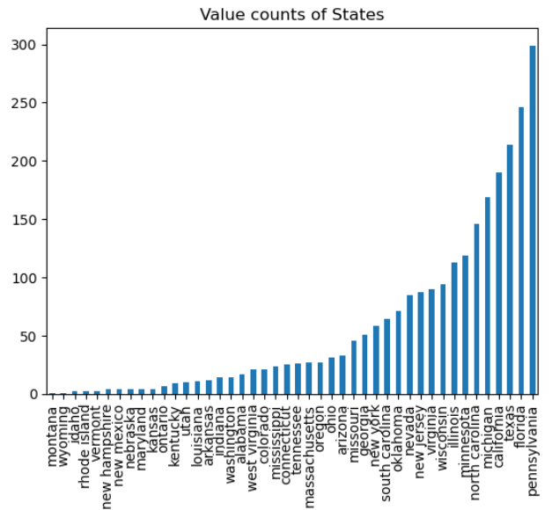
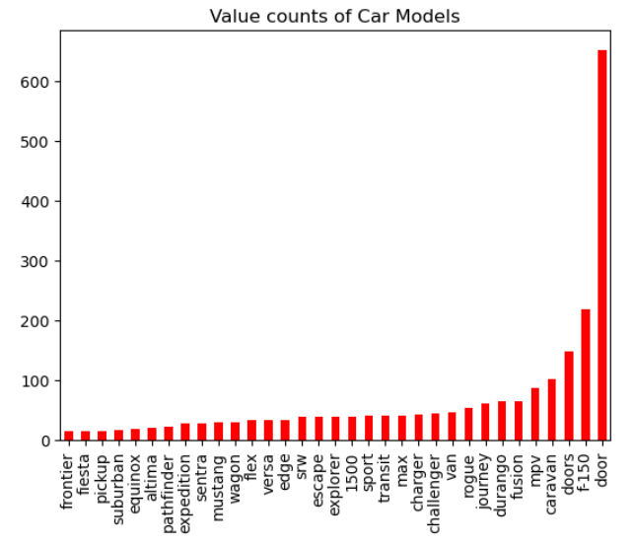

Slide 10
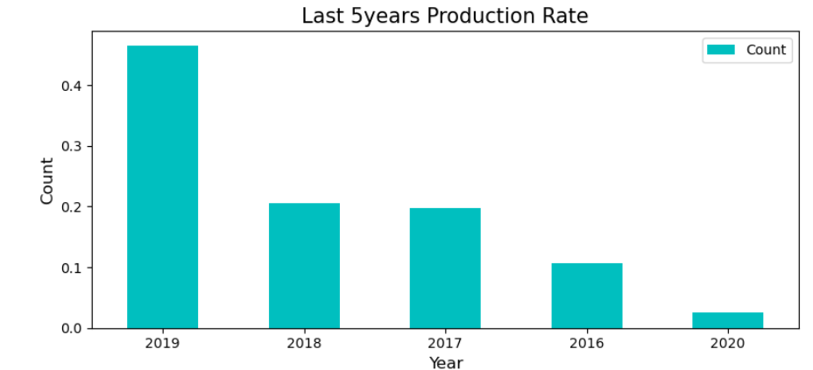
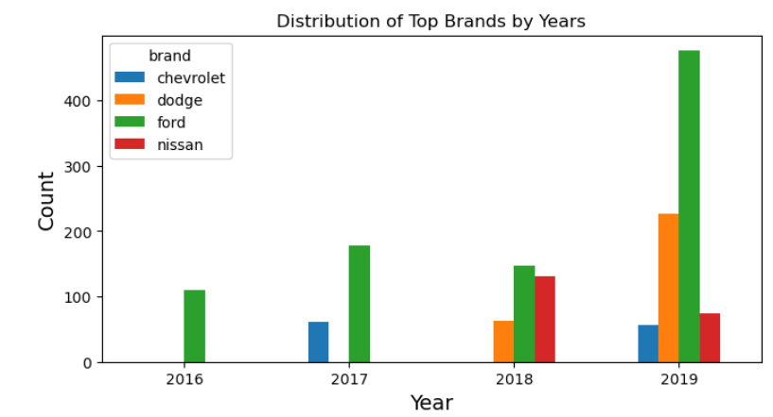

Slide 11
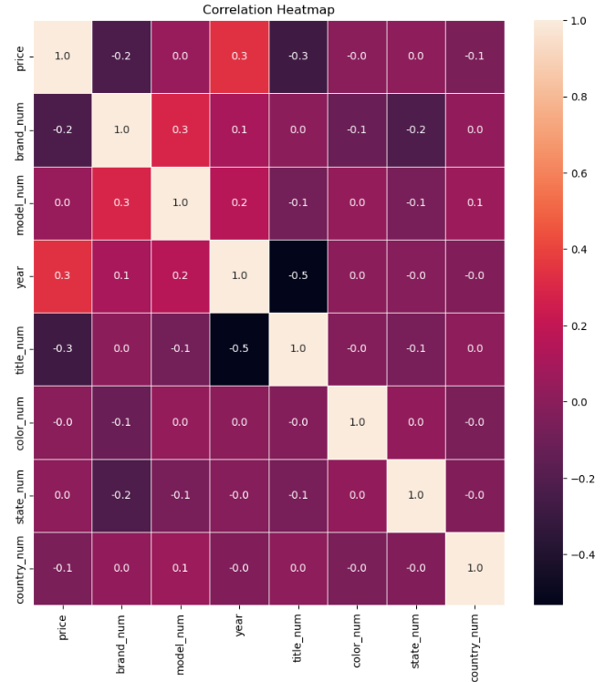
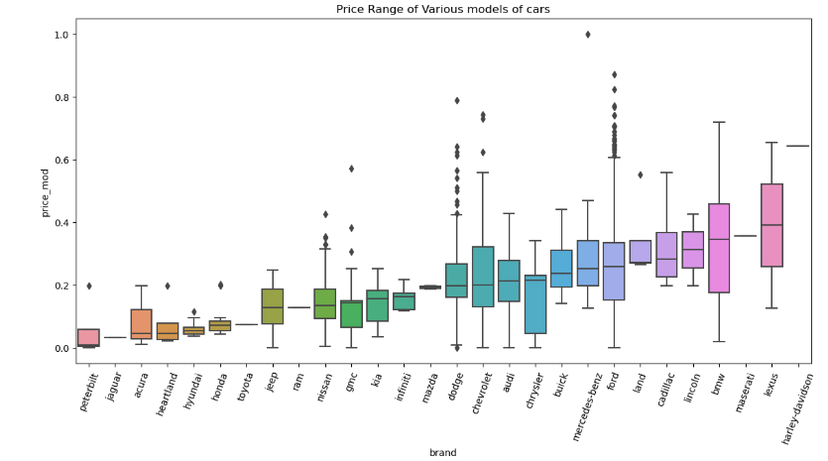

Slide 12
FEATURE ENGINEERING & MODEL BUILDING
The dataset's price column serves as the target variable for constructing models. The remaining columns, including brand, model, manufacturing year, mileage, color, state, and country, are utilized to forecast the price of the car.
Utilizing machine learning algorithms, we can develop predictive models to estimate the price of the Used cars considering various factors like brand, model, manufactured year etc.
Data preprocessing plays a crucial role in machine learning workflows, ensuring data compatibility with models. Standardization and Scaling is applied to numerical features, while encoding techniques handle categorical features.
The dataset is divided into training and testing sets using the train_test_split method. The model is then trained on the training data using the fit method. Predictions are made on the testing data using the predict method. Finally, evaluation metrics such as Mean Absolute Error (MAE), Mean Squared Error (MSE), and R-squared are calculated.

Slide 13
Models used in the project are
Linear Regression Model - The linear regression model utilizes a linear relationship between independent variables and the target variable to make predictions. The accuracy of the model was found to be 57%.
Random Forest Regression Model - The random forest regression model utilizes an ensemble of decision trees to predict the target variable. The accuracy of the model was found to be 75%.
XGBoost Regression Model - The XGBoost regression model utilizes an ensemble of decision trees in a gradient boosting framework to predict the target variable. The accuracy of the model was found to be 73%.
From the above models, the performance of Random Forest Regression makes it the recommended choice for predicting price of Used cars.

Slide 14
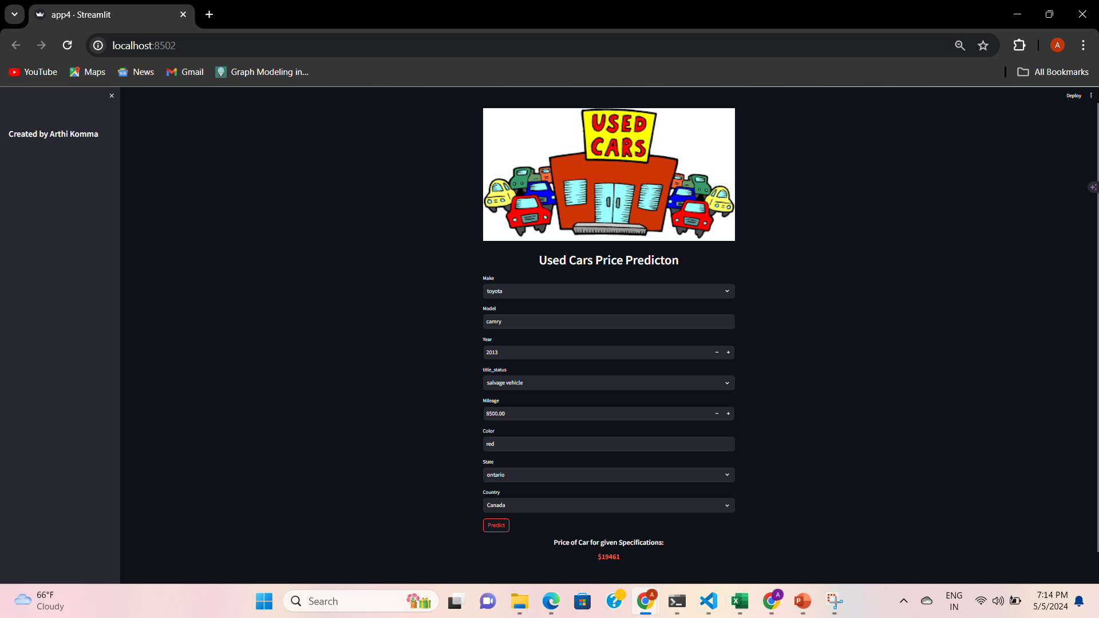
Web Application using Streamlit

Slide 15
Conclusion
Our analysis revealed that the random forest regression model outperformed other models, showcasing superior accuracy in predicting used car prices. This underscores the effectiveness of ensemble methods, particularly in capturing complex relationships within the data. These findings offer valuable insights for stakeholders in the used car market, aiding in pricing strategies and decision-making processes.

Slide 16
Thank you

